Slide 1
Azure Hybrid Data Platform

Slide 2
Monitoring
Location-based Authentication
Serverless
Compute
Orchestrators
Event driven
Machine Learning
Mixed Reality
Compliance
Haptics
Containers
Edge
GPU
DevOps
NoSQL
Automation
Quorum
Microservices
Quantum computing
Log telemetry
Digital Twin
Data privacy
IoT
Blockchain
Big data
Bots
Hybrid cloud
Beacons
Threat Intelligence
Artificial Intelligence
Ambient UX

Slide 3















I’m supposed to use cloud technology, but I don’t know where to start. I’m depending on legacy systems…how should I modernize them?
My agency requires new tech innovations to meet mission goals…expectations are high.
I’m concerned about regulatory requirements and what technology I can utilize.

Slide 4
Monitoring
Location-based Authentication
Serverless
Orchestrators
Compliance
Compute
Event driven
Machine Learning
Mixed Reality
Edge
Haptics
GPU
Containers
Quorum
Log telemetry
Blockchain
NoSQL
Quantum computing
Bio-Wearables
Big data
Artificial Intelligence
DevOps
IoT
Bots
Digital Twin
Data privacy
Beacons
Hybrid cloud
Microservices
Threat Intelligence
Ambient UX

Slide 5
Monitoring
Location-based Authentication
Serverless
Compute
Orchestrators
Event driven
Machine Learning
Compliance
Mixed Reality
Haptics
Containers
Edge
GPU
DevOps
NoSQL
Bio-Wearables
Quorum
Microservices
Quantum computing
Log telemetry
Digital Twin
Data privacy
IoT
Blockchain
Big data
Beacons
Bots
Hybrid cloud
Threat Intelligence
Artificial Intelligence
Ambient UX

Slide 6
Monitoring
Location-based Authentication
Orchestrators
Compute
Serverless
Event driven
Mixed Reality
Machine Learning
Compliance
Haptics
Containers
Edge
GPU
DevOps
NoSQL
Bio-Wearables
Quorum
Microservices
Log telemetry
Quantum computing
Digital Twin
IoT
Blockchain
Data privacy
Big data
Bots
Beacons
Hybrid cloud
Threat Intelligence
Ambient UX
Artificial Intelligence

Slide 7















I’m supposed to be an expert on all the new tech as soon as it comes out…I feel like I’m falling behind.
Now that I use the cloud, the expectations to deliver are much higher.
I want to make stuff that won’t get hacked

Slide 8
The MODERN DATA PROBLEM
Velocity
Real-time
Volume
How to derive value from data:
What happened historically?
What is happening now?
What is going to happen?
ZB
Batch
GB
Structured data
Each dimension of data is constantly expanding
Unstructured data
Variety

Slide 9
Data cacophony
Notes:
As we all know, data volumes are exploding…. Some estimate it’ll reach 44ZB by 2020!

Slide 10










Platform Options
Traditional
on-premises
Infrastructure
(as a Service)
Platform
(as a Service)
Software
(as a Service)
Applications
Applications
Applications
Applications
You manage
Data
Data
Data
Data
Runtime
You manage
Runtime
Runtime
Runtime
Middleware
Middleware
Middleware
Middleware
You manage
O/S
O/S
O/S
Managed by vendor
O/S
Virtualization
Virtualization
Managed by vendor
Virtualization
Virtualization
Servers
Servers
Servers
Servers
Managed by vendor
Storage
Storage
Storage
Storage
Networking
Networking
Networking
Networking
Notes:
As you can see, the cloud journey includes many service scenarios:
On the left, you have a traditional, on-premises infrastructure which you manage completely on your own.
On the right, you have Software-as-a-Service, which includes all of the web-based tools and applications you use to run your business—think of Office 365 or Dynamics 365—running completely in the cloud, and managed fully by the vendor that provides the software.
In the middle, we have infrastructure and platform services. Building out your cloud infrastructure is your first step in moving to the cloud.
Infrastructure as a service (IaaS) is an instant computing infrastructure, provisioned and managed over the Internet. It enables you to quickly scale up and down with demand, and pay only for what you use.
IaaS helps you avoid the expense and complexity of buying and managing your own physical servers and other datacenter infrastructure.
Each resource is offered as a separate service component, and you only need to rent a particular one for as long as you need it.
The cloud computing service provider manages the infrastructure, while you purchase, install, configure, and manage your own software—operating systems, middleware, and applications.

Slide 11
Hybrid = Intelligent Cloud + Intelligent Edge
Multi-device, Multi-sense
Artificial Intelligence
Intelligent cloud
Serverless
Intelligent edge
Notes:
We have an intelligent cloud. You have an intelligent edge.
<more on this and especially what edge means>

Slide 12




























PPT REM 8
Management
Applications
App Frameworks
Hybrid = Choice + Flexibility
Databases & Middleware
Infrastructure
Linux

Slide 13























Hybrid = Open
python
Common Identity
Integrated Management and Security
Consistent Data Platform
Unified Development and DevOps
Notes:
Environments are more complex. We know there’s complexity across the different platforms and systems you use.
Hybrid, heterogeneous, IaaS+PaaS
The average company has more than 30 security solutions and many SaaS apps
Increasingly distributed and physical networks no longer define the perimeter
Microsoft encompasses your heterogeneous environments across these key capabilities and work to integrate with many of the leading vendors in each category.
Identity –Your users can use the same identity on-premises and across thousands of SaaS apps.
Management –You can manage your Windows and Linux VMs wherever they are, on-premises and/or in the cloud.
Data – on our data platform, you can work with any data, any language, any platform. For example, you can use R open source programming language to support big data analytics at enterprise scale--and R Server. R Services allows you to run R integrated with T-SQL stored procedures and R Server (standalone) extends R by providing support, scalability, and security. Customers can also use Hadoop in the cloud or build a Hadoop cluster of their own (Hortonworks Data Platform or Cloudera) that integrates with SQL Server 2016 PolyBase.
Development – Developers can create cloud-ready, business-changing apps and services, whether in the cloud or on-premises, using open-source technologies such as Docker software containers.

Slide 14
Consistent hybrid environment
Hybrid
Azure Active Directory
Azure Data Services
Azure Services
Azure Security & Management
Common Identity
Data Platform
Unified Development
Security & Management
Active Directory
SQL Server
Azure Stack
On-premises Infrastructure
Notes:
Moving to the cloud is a journey unique to each organization. It’s not an all-or-nothing scenario—you can keep as much of your infrastructure on-premises or move it to the cloud as you need to optimize your compute, networking, and storage needs. Azure Infrastructure-as-a-Service solutions make it easy to tailor a solution that is right for you.
Simply put, Azure IaaS helps you connect your on-premises infrastructure to the Cloud.
You might want to with networking offerings, such as Express Route or VPN.
If you would like to move some of your virtual machine compute capacity to the Cloud, you can save money with Azure Hybrid Benefit.
And, if you are running SQL Server, you can move it to a Virtual Machine, or to a SQL managed instance.
You can also easily migrate your storage from on-premises to the cloud with Azure IaaS.
Azure Stack enables you to build the same components for your on-premises infrastructure as for your Cloud infrastructure, so there is no need to build components twice, making infrastructure management easy!
Once you are connected to the cloud, Azure Active Directory helps you with identity management across all of your assets.
Now that you’ve built a secure, cloud-based infrastructure, it’s time to start migrating your data …

Slide 15
Cloud Scale Analytics
Logs (unstructured)
Media (unstructured)
Ingest
Store
Prep
Serve
Reporting
Files (unstructured)
Business/ custom apps (structured)
Azure Data Factory
Azure Data Lake Storage
Azure Databricks
Azure SQL Data Warehouse
Power BI
Notes:
In order to get important insights from data, you need a cloud analytics platform that enables you to easily:
Ingest data of various types from across the enterprise (silos of data) and securely store it
Prep the data for analytics and serve it for reporting
All of this, while maintaining the security, SLAs and governance that you would expect from an enterprise-class solution.

Slide 16

Cloud Scale Analytics
Ingest
Store
Prep
Serve
Reporting
Logs (unstructured)
Media (unstructured)
Files (unstructured)
Azure Data Factory
Azure Data Lake Storage
Azure Databricks
Azure SQL Data Warehouse
Power BI
Business/ custom apps (structured)
Notes:
And with Azure, we provide with you the services you need to do exactly that…

Slide 17
Azure Data Lake Store Gen2
Introductions
Productive
Hybrid
Intelligent
Trusted

Slide 18
WHAT MAKES A GREAT DATA LAKE?
Massive scale
Granular, multi-layered Security
Optimized for Maximum Performance
Integration Friendly
Cost Effectiveness
PB Scale, data accessible everywhere, growth on demand
Granular security and protection against accidental data loss
Lightning quick job execution
Supports multiple methods of data ingress, processing, egress and visualization
Cloud economic model with the ability to intelligently manage costs
Rich Data Management and Governance

Slide 19





Azure Data Lake Storage Gen2
A “no-compromises” Data Lake: secure, performant, massively-scalable Data Lake storage that brings the cost and scale profile of object storage together with the performance and analytics feature set of data lake storage
SECURE
MANAGEABLE
FAST
SCALABLE
COST EFFECTIVE
INTEGRATION READY
Support for fine-grained ACLs, protecting data at the file and folder level
Multi-layered protection via at-rest Storage Service encryption and Azure Active Directory integration
Automated Lifecycle Policy Management
Object Level tiering
Atomic file operations means jobs complete faster
No limits on data store size
Global footprint (50 regions)
Object store pricing levels
File system operations minimize transactions required for job completion
Optimized for Spark and Hadoop Analytic Engines
Tightly integrated with Azure end to end analytics solutions

Slide 20

Azure Data Lake Storage Gen2
ADLS Gen2 adds a high performance HDFS Endpoint to Azure Blob Storage and inherits the rich feature set of Azure Blob Storage *
Blob API
Gen2 API
Unstructured Object Data
File Data
Server Backups, Archive Storage, Semi-structured Data
Hadoop File System, File and Folder Hierarchy, Granular ACLS Atomic File Transactions
Common Blob Storage Foundation
Object Tiering and Lifecycle Policy Management
AAD Integration, RBAC, Storage Account Security
HA/DR support through ZRS and RA-GRS
* Full Blob and HNS Interoperability available in post-GA

Slide 21



ADLS Gen2 key audiences & benefits
Data Engineer
Data Scientists
CDO, VP of analytics
Supports familiar REST API and HDFS file system
Integration with leading Hadoop and Spark analytic engines like Databricks
Low Cost Storage for structured and unstructured data
Strong analytics ISV support
Granular file and folder level security
Supports Azure Active Directory Integration and other advanced security features available in Blob Storage
Fast performance leads to lower end to end analytic job run times
Integration with leading Hadoop and Spark analytic engines like Databricks
Supports integration with visualization tools like Power BI and Tableau
Granular file and folder level security
Low Cost Storage for structured and unstructured data
Meets data sovereignty requirements in multiple geographies
Granular file and folder level security
Supports Azure Active Directory Integration and other advanced security features available in Blob Storage
Inherits object level tiering and advanced HA/DR capabilities of Blob Storage

Slide 22


MODERN DATA WAREHOUSE
INGEST
STORE
PREP & TRAIN
MODEL & SERVE
Logs (unstructured)
Azure Databricks
Media (unstructured)
Polybase
Files (unstructured)
Azure Data Factory
Azure Data Lake Storage
Azure SQL Data Warehouse
Azure Analysis Services
Power BI
Business/custom apps
(structured)

Slide 23


ADVANCED ANALYTICS
INGEST
STORE
PREP & TRAIN
MODEL & SERVE
Logs (unstructured)
Azure Databricks
Cosmos DB
Apps
SparkR
Media (unstructured)
PolyBase
Files (unstructured)
Azure Data Factory
Azure Data Lake Storage
Azure SQL Data Warehouse
Azure Analysis Services
Power BI
Business/custom apps
(structured)

Slide 24

REAL-TIME ANALYTICS
INGEST
STORE
PREP & TRAIN
MODEL & SERVE
Sensors and IoT
(unstructured)
Azure Databricks
Logs (unstructured)
Apache Kafka for HDInsight
Cosmos DB
Real-time apps
Media (unstructured)
Files (unstructured)
PolyBase
Business/custom apps
(structured)
Azure Data Factory
Azure Data Lake Storage
Azure SQL Data Warehouse
Azure Analysis Services
Power BI

Slide 25
Azure AI
Rodrigo Medeiros
Cloud Solutions Architect
Advanced Analytics and AI

Slide 26


Azure AI
a
b
c
AI apps & agents
Knowledge mining
Machine learning
Azure Bot Service
Azure Cognitive Services
Azure Cognitive Search
Azure Databricks
Azure Machine Learning
Azure AI Infrastructure
Notes:
There are three main solutions you can build with Azure AI.
Build AI apps and agents that have the ability to interact with users naturally, with pre-trained AI models and bots
Unlock insights lying latent in your content with Knowledge Mining
Build your own AI machine learning models
As you can see we’ve also outlined the main products for each of these solutions areas.
<Transition> We will go through these one by one

Slide 27
The Azure AI Landscape
Applications
Use AI
Artificial Intelligence in Applications
Cognitive services
Bot framework
Knowledge
Include AI
Artificial Intelligence from Pre-built Services, Apps, and Knowledge Mining
Machine Learning Services, Pretrained Models, Frameworks and Infrastructure, IoT
Create AI
Artificial Intelligence with Platforms, Infrastructure and Tools, Deploy to Edge
Azure Databricks
AI Solutions Gallery
Find AI
Artificial Intelligence Solutions in a Portal

Slide 28
90-Seconds on Machine Learning
Training & Inference
Supervised & Unsupervised
Learning

Slide 29

Azure AI
a
b
c
AI apps & agents
Knowledge mining
Machine learning
Azure Bot Service
Azure Cognitive Services
Azure Cognitive Search
Azure Databricks
Azure Machine Learning
Azure AI Infrastructure
Notes:
There are three main solutions you can build with Azure AI.
Build AI apps and agents that have the ability to interact with users naturally, with pre-trained AI models and bots
Unlock insights lying latent in your content with Knowledge Mining
Build your own AI machine learning models
As you can see we’ve also outlined the main products for each of these solutions areas.
<Transition> We will go through these one by one

Slide 30



Demo: Intelligent apps & agents
Azure AI
a
b
c
AI apps & agents
Knowledge mining
Machine learning
Litware
Start here:
https://github.com/microsoft/botbuilder-samples
Azure Bot Service
Azure Cognitive Services
Azure Cognitive Search
Azure Databricks
Azure Machine Learning
Azure AI Infrastructure
Notes:
https://insurance.litwaredemos.com/
Username: Bot | Password: Azure
Lance Olson
Scripts are available at aka.ms/BotDemoScripts
Also check
https://github.com/Microsoft/BotBuilder
https://github.com/microsoft/botbuilder-samples

Slide 31
AI apps & agents: How the demo was built
Azure AI
a
b
c
AI apps & agents
Knowledge mining
Machine learning
Data
AI
Apps
Azure Cosmos DB
Azure App Service
Web and mobile apps
Vision
Speech
Language
Search
Cognitive Services
Bot Service
SQL DB
CRM
Azure Bot Service
Azure Cognitive Services
Azure Cognitive Search
Azure Databricks
Azure Machine Learning
Azure AI Infrastructure
Notes:
All Apps need databases. With Azure, you have two industry-leading databases for both SQL & NoSQL to handle any variety of data: Azure SQL DB and Azure Cosmos DB, respectively.
Next, the demo utilizes Azure Bot Service. Azure Bot Service provides you an integrated environment that helps you to build, connect, deploy, and manage an intelligent agent to interact naturally with your users. Give your bot the ability to see, hear and interpret your users, as you just saw, by seamlessly integrating Cognitive Services with your bot.
In this particular scenario, the bot is surfaced as a web interface, so we used Web Apps (Azure App Service - Web Apps) to deploy the application.
Note: This agent can also be made available in the CRM tool itself.

Slide 32





Cognitive Services capabilities Infuse your apps, websites, and bots with human-like intelligence
a
b
c
AI apps & agents
Knowledge mining
Machine learning
Vision
Speech
Language
Knowledge
Search
Object, scene, and activity detection
Face recognition and identification
Celebrity and landmark recognition
Emotion recognition
Text and handwriting recognition (OCR)
Video metadata, audio, and keyframe extraction and analysis
Explicit or offensive content moderation
Custom image recognition
Speech transcription (Speech-to-text)
Speech Synthesis (Text-to-speech)
Real-time speech translation
Speaker identification and verification
Custom Speech models for transcription and translation
Custom voice
Language detection
Text sentiment analysis
Key phrase extraction
Entity recognition
Spell checking
Explicit or offensive text content moderation, PII detection
Text translation
Customizable text translation
Contextual language understanding (intent)
Q&A extraction from unstructured text
Knowledge base creation from collections of Q&As
Semantic matching for knowledge bases
Customizable content personalization learning
Ad-free web, news, image, and video search results
Trends for video, news
Image identification, classification and knowledge extraction
Identification of similar images and products
Named entity recognition and classification
Knowledge acquisition for named entities
Search query autosuggest
Ad-free custom search engine creation
Notes:
Vision: Image-processing algorithms to smartly identify, caption and moderate your pictures
Computer vision: Distill actionable information from images
Content Moderator: Automatically moderate potentially offensive images, text and videos
Customer Vision Service: Train a web service to recognize specific content in images
Face: Identify human faces and emotions in images
Video indexer: Easily extract insights from your videos to enrich your applications
Speech: Convert spoken audio into text, use voice for verification, or add speaker recognition to your app
Bing Speech: Convert speech to text and text to speech
Speaker Recognition: Use speech to identify and authenticate individual speakers
Custom Speech Service: Overcome speech recognition barriers like speaking style, background noise, and vocabulary
Translator Speech: Easily conduct real-time speech translation on your app
Language: Enable your apps to process natural language with pre-built scripts, evaluate sentiment and learn how to recognize what users want
Bing Spell Check: Add spell checking functionality to your app
Language Understanding (LUIS): Add language understanding intelligence to your apps with minimal effort
Linguistic Analysis: Easily parse complex text with language analysis
Text Analytics: Easily evaluate sentiment, language, and key phrases to understand what users want
Translator Text: Easily conduct machine translation for 60+ languages
Knowledge: Map complex information and data in order to solve tasks such as intelligent recommendations and semantic search
Knowledge Exploration Service: Enable interactive search experiences over structured data via natural language inputs
Entity Linking Service: Power your app's data links with named entity recognition and disambiguation
Academic Knowledge: Tap into the wealth of academic content in the Microsoft Academic Graph using the Academic Knowledge API
QnA Maker: Distill information into an easy-to-navigate FAQ for bot services
Customer Decision Service: Create custom experiences with adaptive, contextual decision-making
Search: Add Bing Search APIs to your apps and harness the ability to comb billions of webpages, images, videos, and news with a single API call
Bing Autosuggest: Give your app intelligent autosuggest options for searches
Bing News Search: Search for news and get comprehensive results
Bing Web Search: Get enhanced search details from billions of web documents
Bing Entity Search: Enrich your experiences by identifying and augmenting entity information from the web
Bing Image Search: Search for images and get comprehensive results
Bing Video Search: Search for videos and get comprehensive results
Bing Custom Search: Create tailored site search or vertical search experiences for topics you care about
Labs: Cognitive Services Labs are early preview limited availability leading innovation APIs and SDKs that allow developers to start experimenting with Microsoft’s latest and greatest Cognitive Services.
Project Prague: SDK to incorporate gesture-based controls into your apps. Quickly define and implement customized hand gestures, creating a more natural user experience. Limited private preview availability at launch.
Project Cuzco: API to help developers find events associated with Wikipedia entities. Begin with a Wikipedia entity, and receive a list of related events organized by time.
Project Johannesburg: API to calculate route logistics for with deeper location intelligence to account for specific enterprise requirements. IE: weight, height length, hazardous materials, etc.
Project Nanjing: API to calculate isochrones - time and distance-based recommendations for enterprise route optimization.
Project Abu Dhabi: API to create distance matrices, enabling you to calculate a histogram of travel times, and serve as stepping stone for enterprise route optimization.
Project Wollongong: API to help ‘score’ the attractiveness of a location, based on how many of a particular amenity are within a specific distance. Ex: restaurants, parks, transit stops.
With Cognitive Services, developers can easily add intelligent features – such as emotion and sentiment detection, vision and speech recognition, knowledge, search and language understanding – into their applications. The collection will continuously improve, adding new APIs and updating existing ones.
Cognitive Services includes:
<click>
Vision: From faces to feelings, allow apps to understand images and video
<click>
Speech: Hear and speak to users by filtering noise, identifying speakers, and understanding intent
<click>
Language: Process text and learn how to recognize what users want
<click>
Knowledge: Tap into rich knowledge amassed from the web, academia, or your own data
<click>
Search: Access billions of web pages, images, videos, and news with the power of Bing APIs
Why choose these APIs? They work, and it’s easy.
<click>
Easy: The APIs are easy to implement because of the simple REST calls. There’s a common way to implement, and you can get started with all of them for free simply by going to one place, one website, www.microsoft.com/cognitive.
Flexible: We’ve got a breadth of intelligence and knowledge APIs so developers will be able to find what intelligence feature they need. And, importantly, they all work on whatever language, framework, or platform developers choose. So, developers can integrate into their apps—iOS, Android, Windows—using their own tools they know and love.
Tested: Tap into an ever-growing collection of powerful AI algorithms developed by experts. Developers can trust the quality and expertise build into each API by experts in their field from Microsoft’s Research organization, Bing, and Azure machine learning and these capabilities are used across many Microsoft first party products such as Cortana, Bing and Skype.
Transition: When it comes to real-world applications for Cognitive Services, the sky is the limit! Let’s look at some examples.
<click>

Slide 33
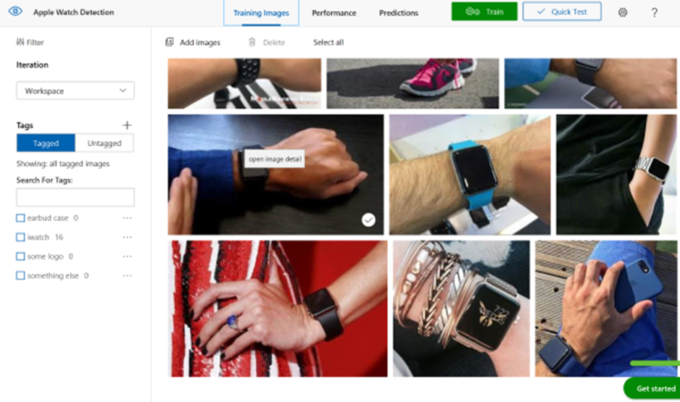
Demo: Object Detection
Azure AI
a
b
c
AI apps & agents
Knowledge mining
Machine learning
Cognitive Services
Custom Vision
http://customvision.ai
Azure Bot Service
Azure Cognitive Services
Azure Cognitive Search
Azure Databricks
Azure Machine Learning
Azure AI Infrastructure

Slide 34






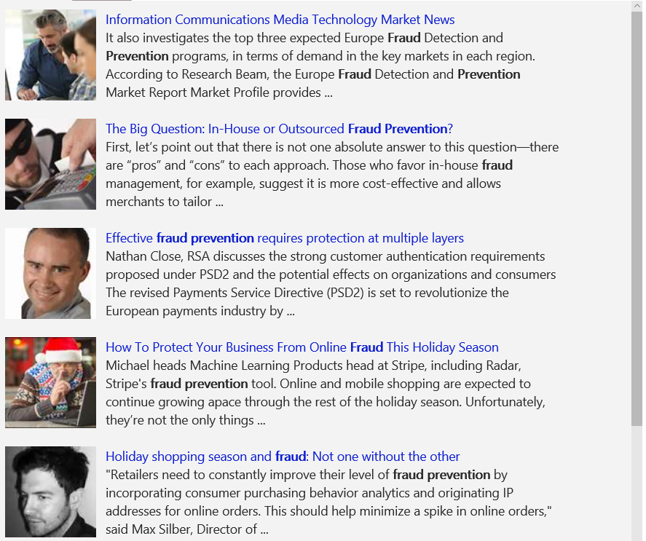
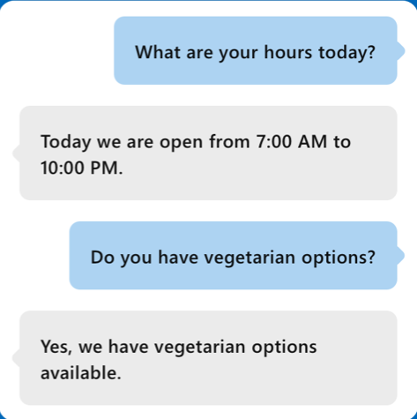
A variety of real-world applications
a
b
c
AI apps & agents
Knowledge mining
Machine learning
Vision
Speech
Language
Knowledge
Search
What is in the image or video?
Give me directions to the nearest local branch
Play today’s customer call recording
QnA Pair of this site?
Search for ‘fraud prevention’
Intelligent Image insights
Speech to text
Natural Language Processing
Automatic extraction of questions and answers
Intelligent web search
Information Communications Media Market News
It also investigates the top three expected Fraud Detection and Prevention programs, in terms of demand in key markets…
Intent: PlayCall
Content: Customer#
DateTime.date: today
The Big Question: In-House or Outsourced Fraud Protection?
First, let’s point out that there is not one absolute answer—there are “pros” and “cons” to each. Those who favor in-house…
Category | People; 5 faces
Adult/Racy? | False/False
Dominant colors
Accent color
Convert spoken audio to text
How to Protect Your Business from Online Fraud this Holiday Season
Michael heads fraud prevention tool. Online and mobile shopping are expected to continue growing apace…
Computer Vision
Speech Service
Language Understanding
QnA Maker
Bing News Search
Convert text to spoken audio
Now Playing
Extract intent of user
11/29/2016 Customer Call
Notes:
Cognitive services span Vision, Speech, Language, Knowledge, and Search. Combining many of these services together can either improve user interaction models, or provide fun and engaging user experiences.
Our examples here shine some light on how some of these APIs work in real-world situations:
Vision
The Computer Vision API is able to extract rich information from images to categorize and process visual data and protect your users from unwanted content. Here, the API is able to tell us what the photo contains, indicate the most common colors, and lets us know that the content would not be considered inappropriate for users.
Speech
The Bing Speech API is capable of converting audio to text, understanding intent, and converting text back to speech for natural responsiveness. This case shows us that the user has asked for directions verbally, the intent has been extracted, and a map with directions provided.
Language:
Language Understanding Intelligent Service, known as LUIS, can be trained to understand user language contextually, so your app communicates with people in the way they speak. The example we see here demonstrates Language Understanding’s ability to understand what a person wants, and to find the pieces of information that are relevant to the user’s intent.
Knowledge
Knowledge Exploration Service adds interactive search over structured data to reduce user effort and increase efficiency. Our Knowledge Exploration API example here demonstrates the usefulness of this API for answering questions posed in natural language in an interactive experience.
Search
Bing Image Search API enables you to add a variety of image search options to your app or website, from trending images to detailed insights. Users can do a simple search, and this API scours the web for thumbnails, full image URLs, publishing website info, image metadata, and more before returning results.
Transition: These APIs are available as stand-alone solutions, or as part of the Cortana Intelligence Suite. They can also be used in conjunction with the Microsoft Bot Framework.
<click>

Slide 35
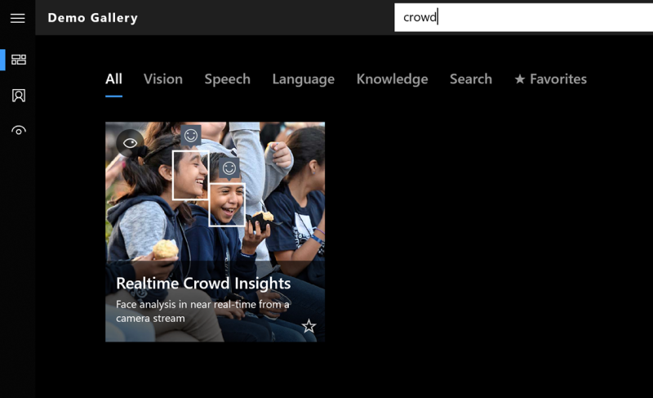
Demo: Crowd Insights
Azure AI
a
b
c
AI apps & agents
Knowledge mining
Machine learning
Cognitive Services
Intelligent Kiosk
Azure Bot Service
Azure Cognitive Services
Azure Cognitive Search
Azure Databricks
Azure Machine Learning
Azure AI Infrastructure

Slide 36
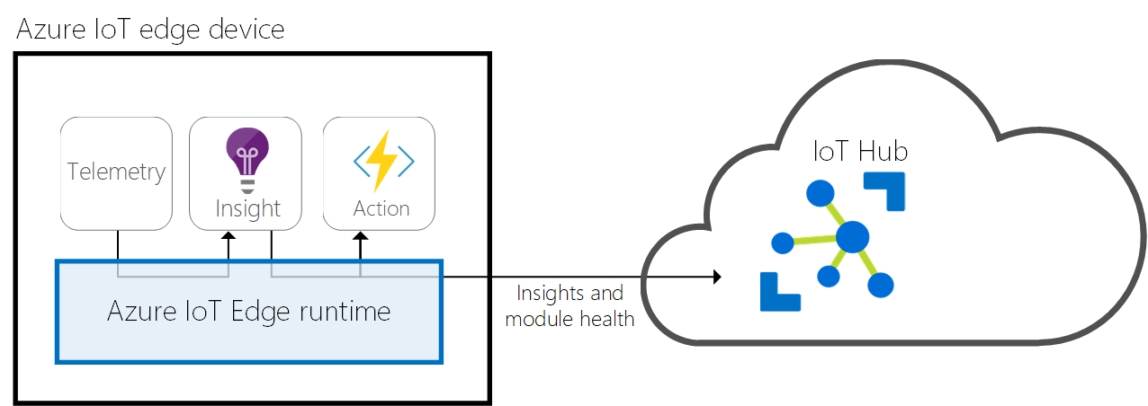
Cognitive Services and Custom AI – on the Edge
Installs and updates workloads on the device.
Maintains Azure IoT Edge security standards on the device.
Ensures that IoT Edge modules are always running.
Reports module health to the cloud for remote monitoring.
Facilitates communication between downstream leaf devices and the IoT Edge device.
Facilitates communication between modules on the IoT Edge device.
Facilitates communication between the IoT Edge device and the cloud

Slide 37

Azure AI
a
b
c
AI apps & agents
Knowledge mining
Machine learning
Azure Bot Service
Azure Cognitive Services
Azure Cognitive Search
Azure Databricks
Azure Machine Learning
Azure AI Infrastructure
Notes:
There are three main solutions you can build with Azure AI.
Build AI apps and agents that have the ability to interact with users naturally, with pre-trained AI models and bots
Unlock insights lying latent in your content with Knowledge Mining
Build your own AI machine learning models
As you can see we’ve also outlined the main products for each of these solutions areas.
<Transition> We will go through these one by one

Slide 38







Machine Learning on Azure
Domain Specific Pretrained Models
To reduce time to market
…
Vision
Speech
Language
Search
Familiar Data Science Tools
To simplify model development
PyCharm
Jupyter
Visual Studio Code
Command line
Popular Frameworks
To build machine learning and deep learning solutions
PyTorch
TensorFlow
Scikit-Learn
ONNX
Productive Services
To empower data science and development teams
Azure Databricks
Azure Machine Learning
Machine Learning VMs
Powerful Infrastructure
To accelerate deep learning
CPU
GPU
FPGA
From the Intelligent Cloud to the Intelligent Edge

Slide 39


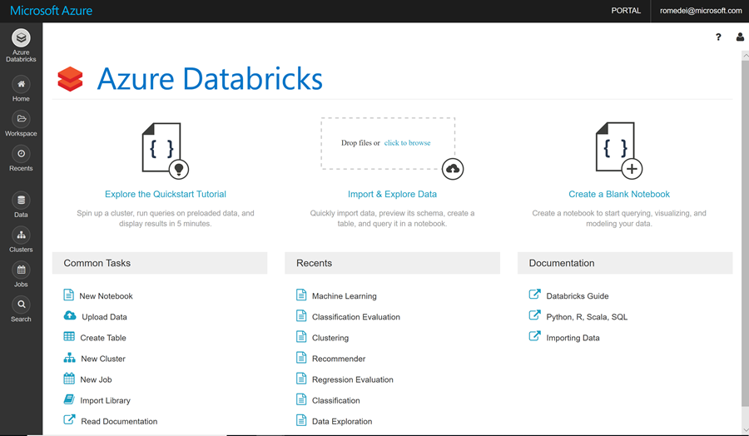
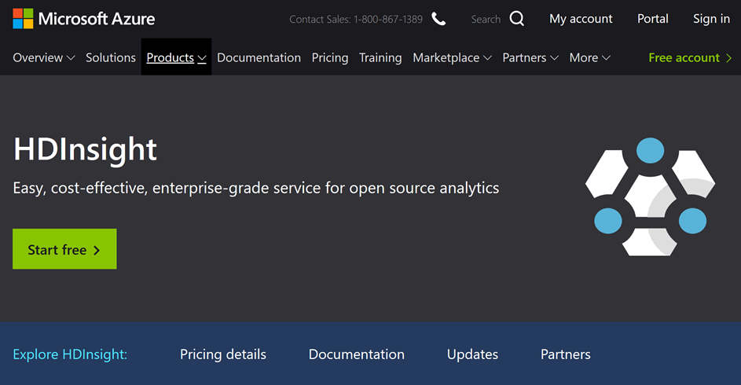
Big Data: Databricks, HD Insight / Hadoop
c
a
b
AI apps & agents
Knowledge mining
Machine learning

Slide 40




Big Data Solutions
POSITIONING THE DIFFERENT BIG DATA SOLUTIONS
CONTROL
EASE OF USE
Azure Databricks
Frictionless & Optimized Spark clusters
Azure HDInsight
Workload optimized, managed clusters
Reduced Administration
Azure Marketplace
HDP | CDH | MapR
BIG DATA ANALYTICS
Any Hadoop technology, any distribution
IaaS Clusters
Managed Clusters
Azure Data Lake Analytics
Azure Data Lake Store
BIG DATA STORAGE
Azure Storage

Slide 41
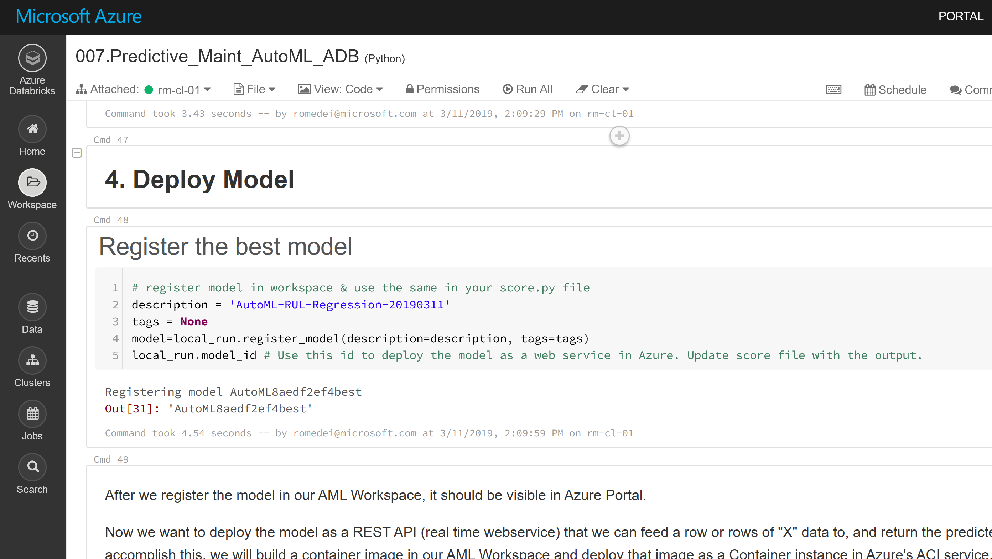
Quick Look: Databricks Workspace
Azure AI
c
a
b
AI apps & agents
Knowledge mining
Machine learning
Azure Bot Service
Azure Cognitive Services
Azure Cognitive Search
Azure Databricks
Azure Machine Learning
Azure AI Infrastructure

Slide 42
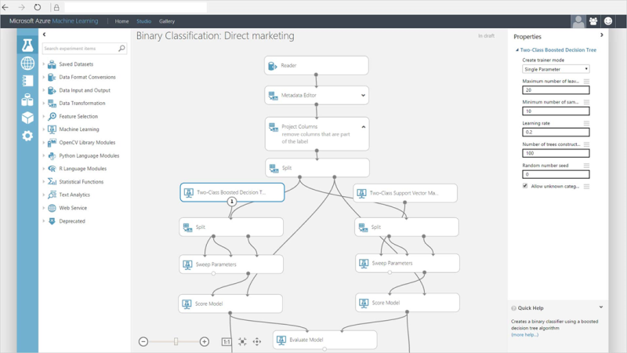
Machine Learning Studio
c
a
b
AI apps & agents
Knowledge mining
Machine learning
Visual Development Environment
Fast experimentation rate
Easy to make models available as web service
Great for “no data in laptops” model
Sample Data Sources, Tutorials
Free edition available
http://studio.azureml.net

Slide 43
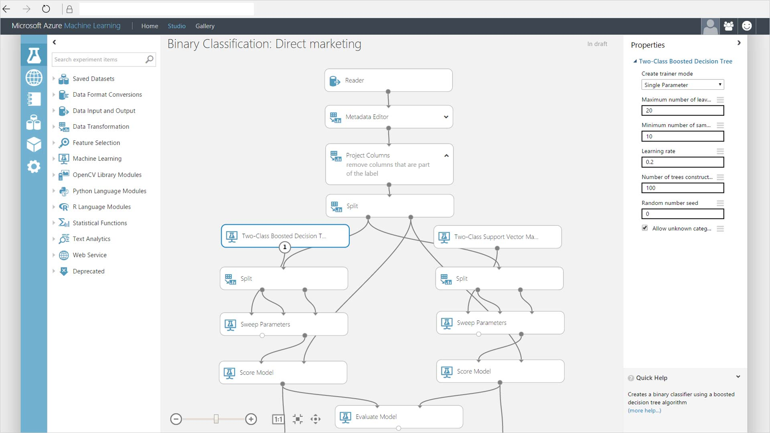
Quick Look: Machine Learning Studio
Azure AI
c
a
b
AI apps & agents
Knowledge mining
Machine learning
Azure Bot Service
Azure Cognitive Services
Azure Cognitive Search
Azure Databricks
Azure Machine Learning
Azure AI Infrastructure

Slide 44
Azure Automated ML
Which features?
Which algorithm?
Which parameters?
Mileage
Condition
Car brand
Year of make
Regulations
…
Gradient Boosted
Nearest Neighbors
SVM
Bayesian Regression
LGBM
…
Parameter 1
Parameter 2
Parameter 3
Parameter 4
…
Mileage
Gradient Boosted
Criterion
Loss
Min Samples Split
Min Samples Leaf
Others
Car brand
Year of make
30%
Model

Slide 45
Model Creation Is Typically Time-Consuming
Which features?
Which algorithm?
Which parameters?
Mileage
Condition
Car brand
Year of make
Regulations
…
Gradient Boosted
Nearest Neighbors
SVM
Bayesian Regression
LGBM
…
Criterion
Loss
Min Samples Split
Min Samples Leaf
Others
Mileage
Gradient Boosted
N Neighbors
Weights
Metric
P
Others
Condition
Nearest Neighbors
Car brand
Car brand
50%
Year of make
30%
Year of make
Model
Iterate

Slide 46
Automated ML Finds the Best Combination
Which features?
Which algorithm?
Which parameters?
30%
50%
70%
30%
45%
50%
65%
95%
35%
10%
75%
20%
70%
30%
15%
Iterate

Slide 47
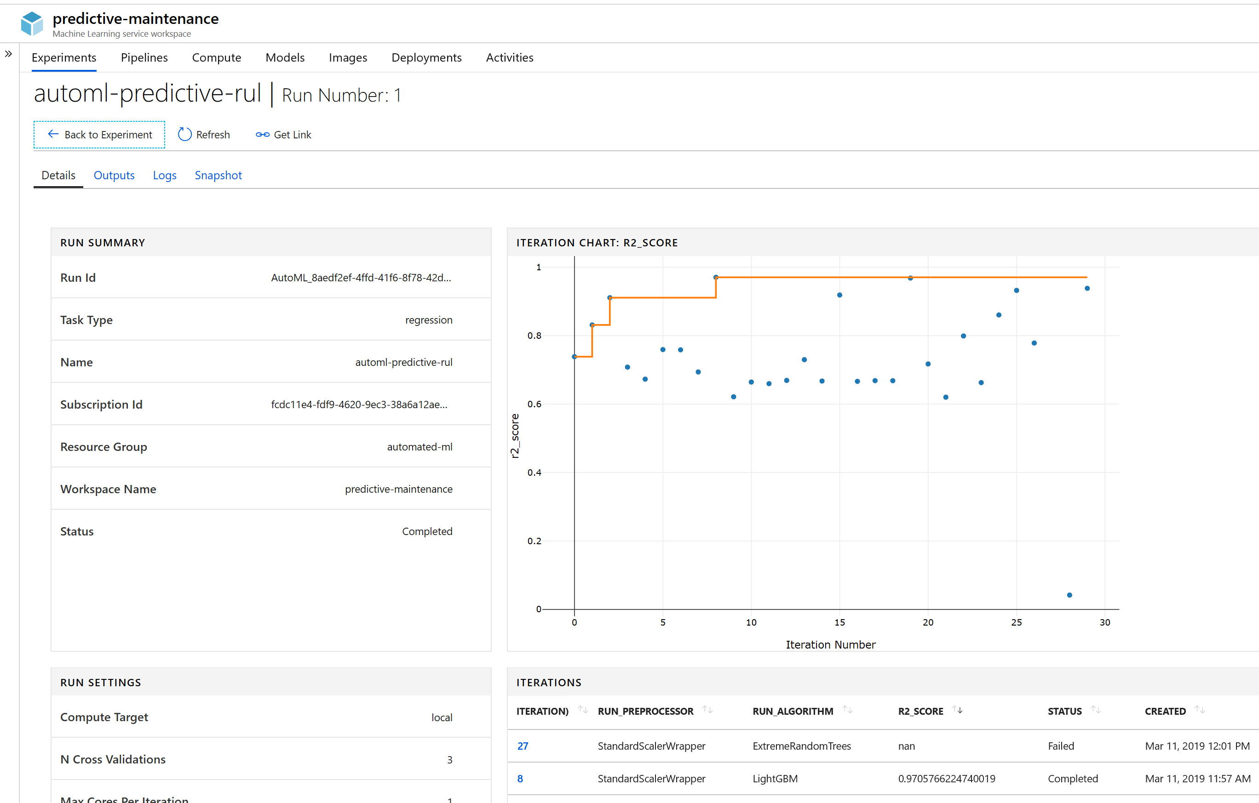
Azure Automated ML
c
a
b
AI apps & agents
Knowledge mining
Machine learning
Azure Automated ML lets you
Automate the exploration process
Use resources more efficiently
Optimize model for desired outcome
Control resource budget
Keep track of model versions
Keep track of deployed models
Apply it to different models and learning domains
Pick training frameworks of choice
Visualize all configurations in one place

Slide 48
Quick Look: Machine Learning Service & Automated ML with Databricks
Azure AI
c
a
b
AI apps & agents
Knowledge mining
Machine learning
https://github.com/parasharshah/automl-handson
Import notebook “007.Predictive_Maint_AutoML_ADB.dbc”
Azure Bot Service
Azure Cognitive Services
Azure Cognitive Search
Azure Databricks
Azure Machine Learning
Azure AI Infrastructure
Notes:
Follow the setup instructions to install the SDK and Automated ML library.

Slide 49



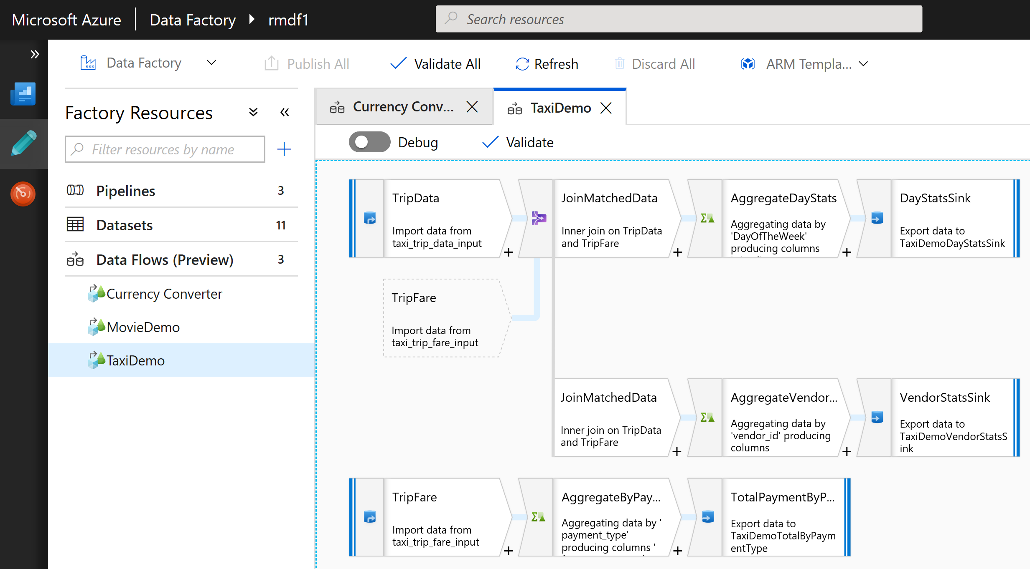

Azure Data Factory Hybrid data integration, cloud-native, at big data scale
PRODUCTIVE
HYBRID
TRUSTED
SCALABLE
Drag & Drop UI
Codeless Data Movement
Orchestrate where your data lives
Lift SSIS packages to Azure
Certified compliant Data Movement
Serverless scalability with no infrastructure to manage

Slide 50
Azure AI
a
b
c
AI apps & agents
Knowledge mining
Machine learning
Azure Bot Service
Azure Cognitive Services
Azure Cognitive Search
Azure Databricks
Azure Machine Learning
Azure AI Infrastructure
Notes:
There are three main solutions you can build with Azure AI.
Build AI apps and agents that have the ability to interact with users naturally, with pre-trained AI models and bots
Unlock insights lying latent in your content with Knowledge Mining
Build your own AI machine learning models

Slide 51
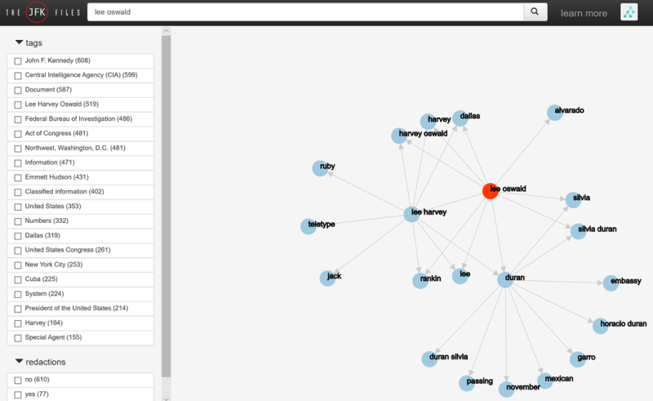
Quick Look: The JFK Files
Enrich Data with Cognitive Services
Live website: https://jfkfiles2.azurewebsites.net/
Solution code and description: https://www.ailab.microsoft.com/experiments/jfk-files

Slide 52
Start AI with Ethics
Microsoft believes that AI technology should embody the following principles:
Fair - AI must maximize efficiencies without destroying dignity and guard against bias
Accountable - AI must have algorithmic accountability
Transparent - AI must be transparent
Ethical - AI must assist humanity and be designed for intelligent privacy
https://tinyurl.com/learnai-AIEthics

Slide 53
Additional Resources
https://aischool.microsoft.com/en-us/home
https://azure.github.io/LearnAI-Bootcamp/
https://docs.microsoft.com/en-us/azure/architecture/
https://www.microsoft.com/en-us/TrustCenter/CloudServices/Azure
https://azure.microsoft.com/en-us/blog/running-cognitive-services-on-iot-edge/
https://gallery.azure.ai/Tutorial/Energy-Demand-Forecast-Template-with-SQL-Server-R-Services-1
Custom Vision: https://vi.microsoft.com/
Auto ML with Databricks notebook example: https://github.com/parasharshah/automl-handson
Machine Learning Studio: https://studio.azureml.net/
UPS Story (Bot)
https://customers.microsoft.com/en-us/story/ups

Slide 54
Contacts
Andres Urrutia | andres.urrutia@microsoft.com
Cloud Solutions Architect
Applications and Infrastructure
Rodrigo Medeiros | rodrigo.Medeiros@microsoft.com
Cloud Solutions Architect
Data and AI

Slide 55
Advanced analytics on big data
Ingest
Store
Prep & train
Model & serve
Logs (unstructured)
Azure Databricks
Azure Cosmos DB
Apps
Media (unstructured)
Polybase
Files (unstructured)
Azure Data Factory
Azure Blob Storage
Azure SQL Data Warehouse
Azure Analysis Services
Power BI
Business/custom apps
(structured)
Microsoft Azure also supports other Big Data services like Azure HDInsight and Azure Data Lake to allow customers to tailor the above architecture to meet their unique needs.

Slide 56
Real-time analytics
Ingest
Store
Prep & train
Model & serve
Sensors and IoT
(unstructured)
Azure Event Hubs
Azure IoT Hub
Azure Databricks
Azure Cosmos DB
Apps
Logs (unstructured)
Media (unstructured)
Files (unstructured)
Azure Data Factory
Azure Blob Storage
Azure SQL Data Warehouse
Azure Analysis Services
Power BI
Business/custom apps
(structured)
Microsoft Azure also supports other Big Data services like Azure HDInsight and Azure Data Lake to allow customers to tailor the above architecture to meet their unique needs.
Notes:
Microsoft Azure supports other services like Azure HDInsight, Azure Data Lake, Azure IoT Hub, Azure Events Hub in various layers of the architecture above to allow customers a truly customized solution.

